Slide 1
M. Tech (CSE) – Second Semester (Term: June-Oct 2022) Non CIE component on Quantum Computing Essentials
Ramaiah Institute of Technology
(Autonomous Institute, Affiliated to VTU)
Department of Computer Science and Engineering
Faculty: Dr. S RAJARAJESWARI
Presented By:
Anubhuti Verma
1MS21SCS02

Slide 2
QUANTUM COMPUTING
By Definition:
“It is the computer technology based on the principles of quantum theory, which explains the nature and behaviour of the energy and matter on the quantum(atomic/subatomic) level.”

Slide 3
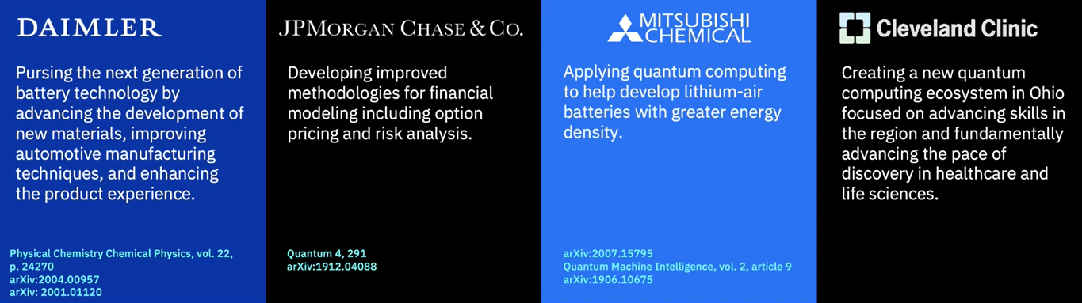
APPLICATIONS

Slide 4
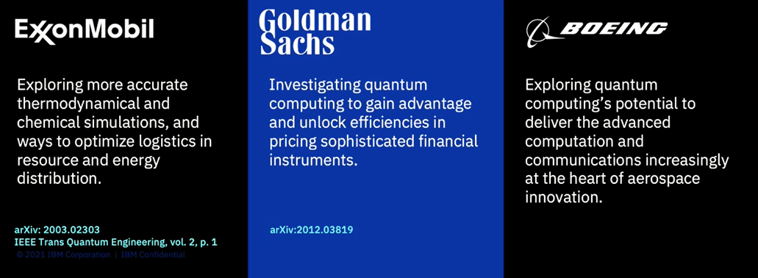
APPLICATIONS

Slide 5
OPPORTUNITIES
Quantum Kernel Developers:
Develop high performance circuits.
Quantum Algorithm Developers:
Develop ground breaking algorithms That are advantageous over classical solutions.
Quantum Model Developers:
Applying the algorithms to real world use cases like automotive, finance, medical, optimization.

Slide 6
ADVANTAGES
Much faster than classical computing
Runs complex simulations
More secure encryption
Solves problem that cant be processed stated by the Church-Turing thesis.

Slide 7
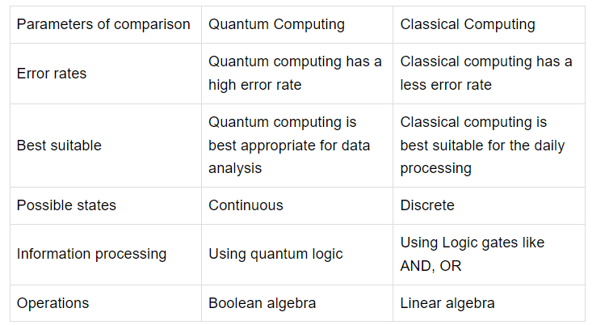
Differences between quantum and classical computing.

Slide 8

EIGEN VALUES AND VECTORS
An eigenvector of a linear operator A on a vector space is a non-zero vector |v> such that
where v is a complex number known as the eigenvalue of A corresponding to |v>

Slide 9

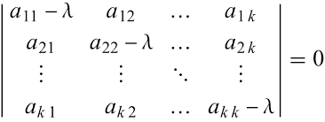
CHARACTERISTIC EQUATION
Characteristic function:
Matrix representation of the equation:

Slide 10

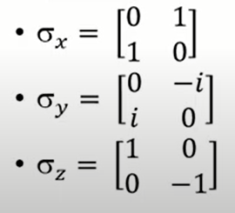
DIAGONAL REPRESENTATION
The diagonal representation for an operator A on vector space V is representation:
The diagonal representation of a matrix is defined as the matrix written in the basis in which it is diagonal.
Pauli’s matrices

Slide 11
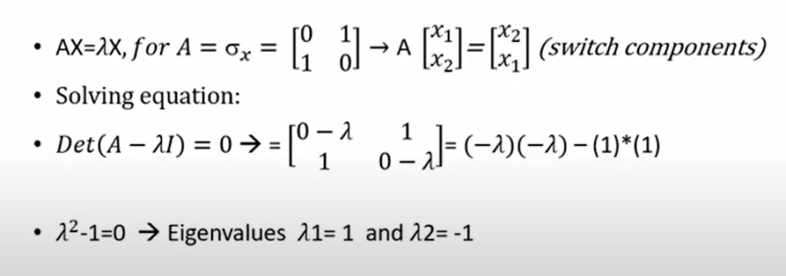
CALCULATING EIGEN VECTORS
MATRIX X:

Slide 12
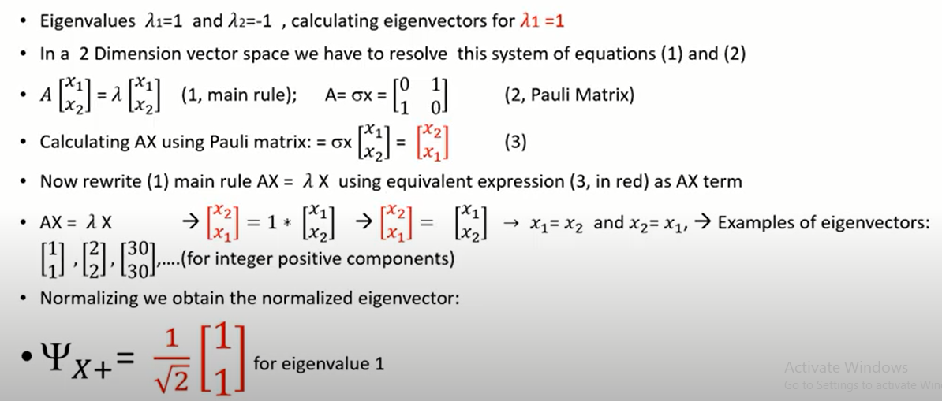

Slide 13
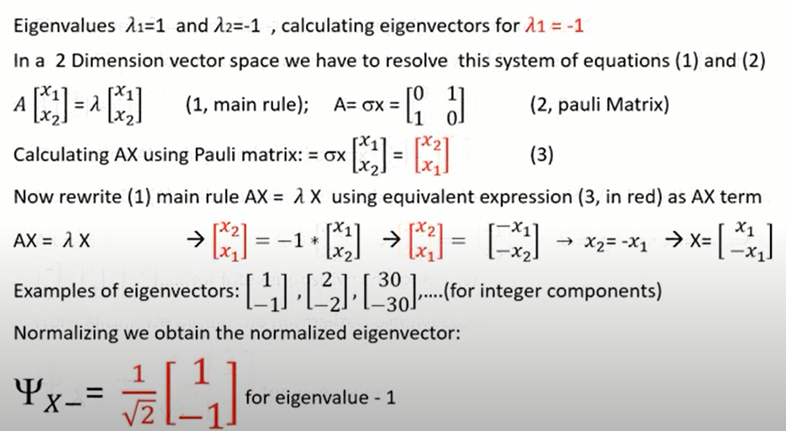

Slide 14
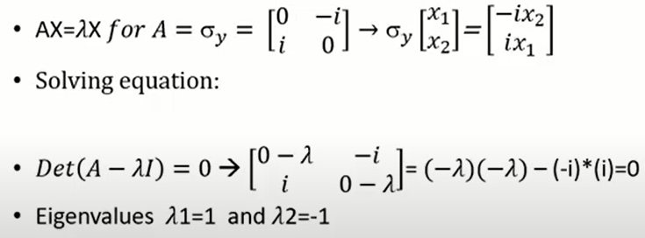

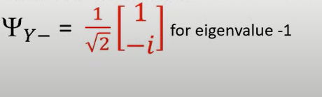
EIGEN VALUE AND VECTORS FOR MATRIX Y

Slide 15
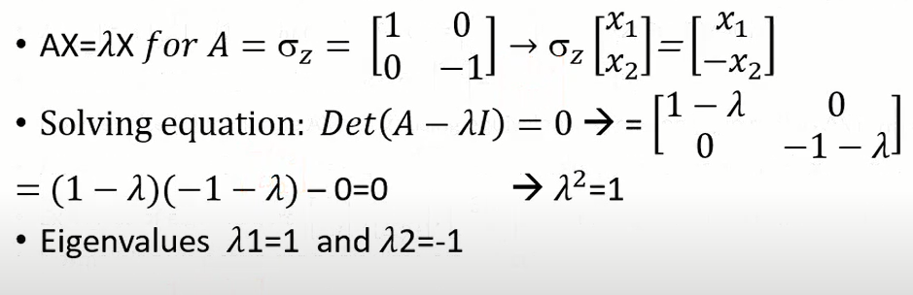
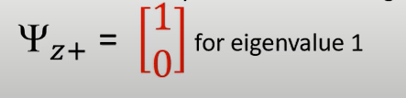
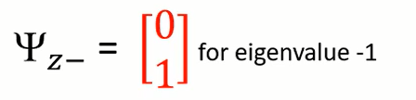
EIGEN VALUE AND VECTORS FOR MATRIX Z

Slide 16
TENSOR PRODUCT
The tensor product is a way of putting vector spaces together to form larger vector spaces.
Each subsystem is described by a vector in a vector space (Hilbert space).
For example,
Let us have two systems I and II with their corresponding Hilbert spaces HI and HII.
Thus, using the bra-ket notation,
the vectors ∣ψI⟩ and ∣ψII⟩ describe the states of system I and II with the state of the total system given by the tensor product ∣ψI⟩ ⊗ ∣ψII⟩.

Slide 17
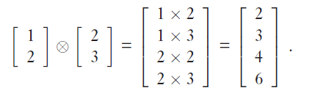
MATRIX REPRESENTATION

Slide 18
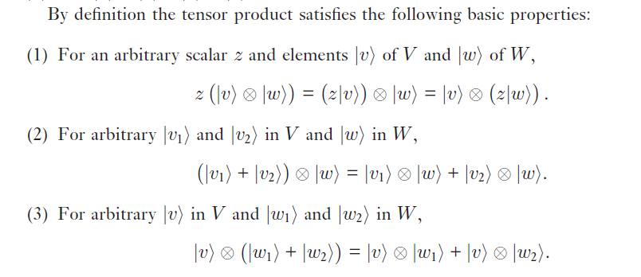
PROPERTIES

Slide 19
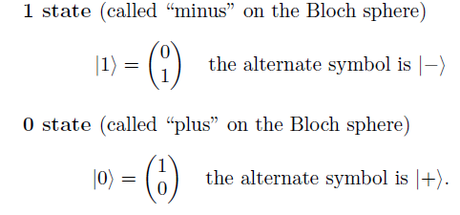
QUBIT BASIS STATE
A qubit is the fundamental quantum state representing the smallest unit of quantum information containing one bit of classical information accessible by measurement.
∣0⟩
∣1⟩

Slide 20
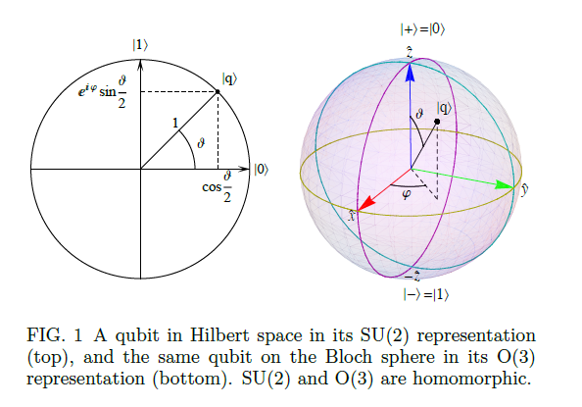
REPRESENTATION USING BLOCH SPHERE

Slide 21
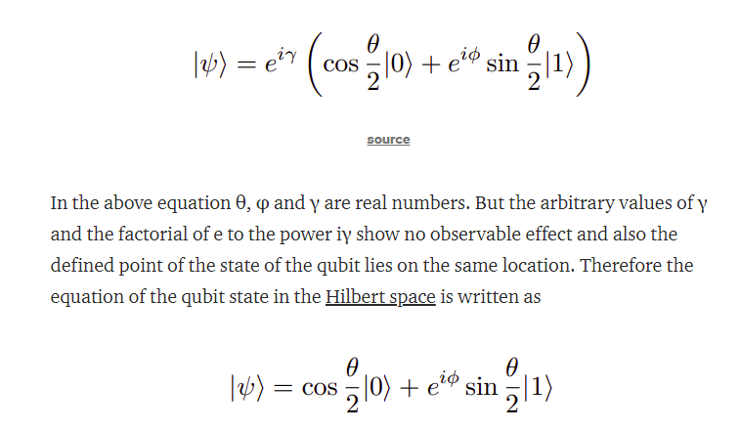
QUBIT

Slide 22
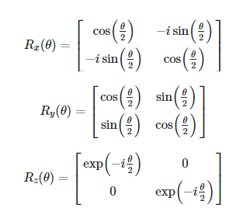
ROTATION ABOUT X, Y AND Z AXIS
Rotation in x, y and z in bloch sphere.

Slide 23
THANK YOU!

